Slide 1
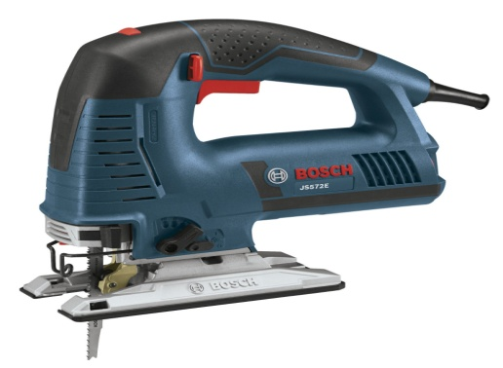
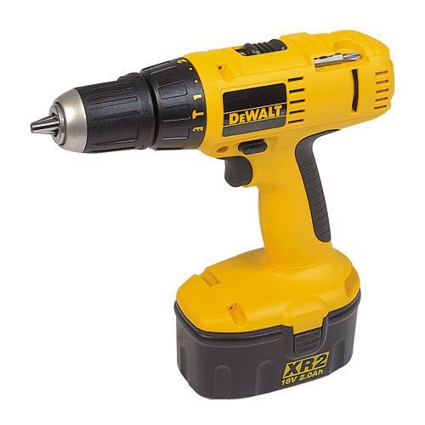
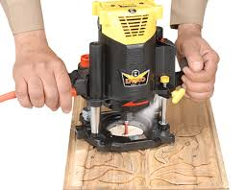
Power tools and Machinery
Name:...........................................
Form:............................................
Date:.............................................
Look at the range of power tools and machinery displayed below and highlight the name use and the safety precautions that must be taken when using the equipment. Discuss safety equipment that must also be worn to ensure a safe working are and environment. Ensure that you use full sentences and record your answers in detail displaying your knowledge and understanding of the equipment using key language.
Equipment Name:.................................
Machine Use:.................................................................................................................................................................................................................................................
Health and Safety:...............................................................................................................................................................................
Equipment Name:.................................
Machine Use:.................................................................................................................................................................................................................................................
Health and Safety:...............................................................................................................................................................................
Equipment Name:.................................
Machine Use:.................................................................................................................................................................................................................................................
Health and Safety:...............................................................................................................................................................................
Highlight and explain how this equipment could be used to manufacture certain products/features
Highlight and explain how this equipment could be used to manufacture certain products/features
Highlight and explain how this equipment could be used to manufacture certain products/features

Slide 2
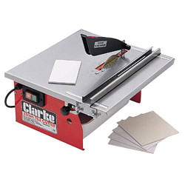
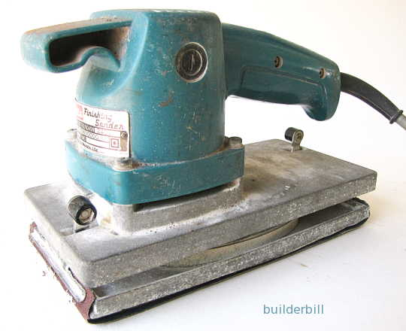
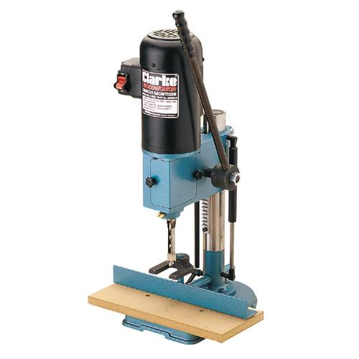
Power tools and Machinery
Name:...........................................
Form:............................................
Date:.............................................
Equipment Name:.................................
Machine Use:.................................................................................................................................................................................................................................................
Health and Safety:...............................................................................................................................................................................
Equipment Name:.................................
Machine Use:.................................................................................................................................................................................................................................................
Health and Safety:...............................................................................................................................................................................
Equipment Name:.................................
Machine Use:.................................................................................................................................................................................................................................................
Health and Safety:...............................................................................................................................................................................
Highlight and explain how this equipment could be used to manufacture certain products/features
Highlight and explain how this equipment could be used to manufacture certain products/features
Highlight and explain how this equipment could be used to manufacture certain products/features

Slide 3
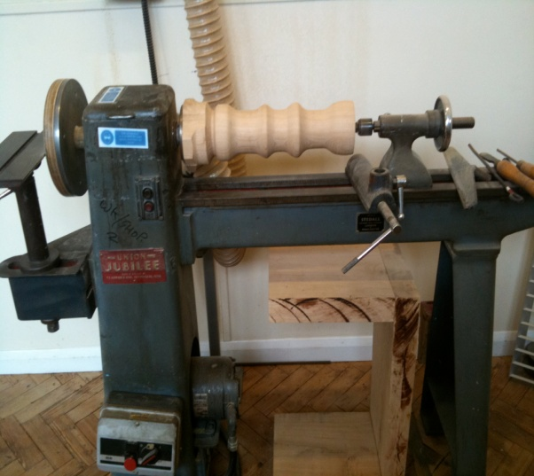
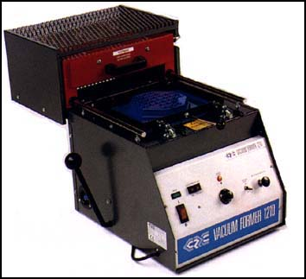
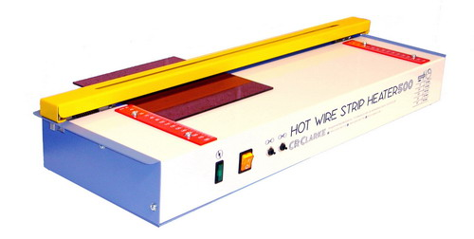
Power tools and Machinery
Name:...........................................
Form:............................................
Date:.............................................
Equipment Name:.................................
Machine Use:.................................................................................................................................................................................................................................................
Health and Safety:...............................................................................................................................................................................
Equipment Name:.................................
Machine Use:.................................................................................................................................................................................................................................................
Health and Safety:...............................................................................................................................................................................
Equipment Name:.................................
Machine Use:.................................................................................................................................................................................................................................................
Health and Safety:...............................................................................................................................................................................
Highlight and explain how this equipment could be used to manufacture certain products/features
Highlight and explain how this equipment could be used to manufacture certain products/features
Highlight and explain how this equipment could be used to manufacture certain products/features

