Slide 1
Chemistry Revision AQA Trilogy Use your PLC to identify which topic you need to revise & complete the relevant task
C1 Atomic Structure and the Periodic Table
C2 Bonding, structure and the properties of matter
C3 Quantitative Chemistry
C4 Chemical changes
C5 Energy changes
Assessment – Paper 3: Chemistry 1 (70 marks -16.7% of GCSE )

Slide 2
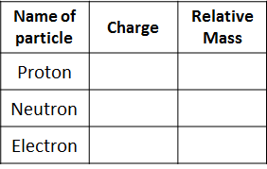
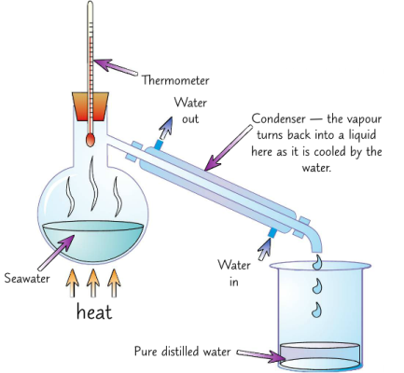
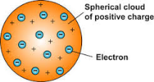
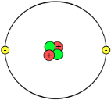
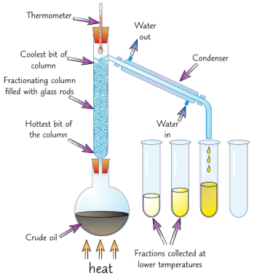
C1 Atomic Structure and the Periodic Table AQA Trilogy | Write the word equation for: Burning magnesium in air Can you write the balanced symbol equation? | Explain crystallisation as a separation technique
Define the following terms: Atom Element Compound Mixture | Balance the symbol equations below: H₂SO₄ + NaOH → Na₂SO₄ + H₂O Zn + O₂ → ZnO CH₄ + O₂ → CO₂ + H₂O | Draw a diagram to illustrate chromatography as a separation technique | Number of protons = Number of neutrons = Number of electrons =
Write the symbols for the following elements: Oxygen Carbon Sodium Magnesium Chlorine Copper |  | Explain simple distillation as a separation technique, shown in the diagram | Describe the difference between the plum pudding and the nuclear model of an atom
Write the name of the compound: CO₂ H₂O NaCl CuSO₄ |  | Explain fractional distillation as a separation technique | Where in an atom are the neutrons and proton? The number of protons = the number of_________ Atomic number is the number of _________ Mass number is the number of ________ + the number of _________ Isotopes have a different number of ____________
Simple distillation
fractional distillation

Slide 3
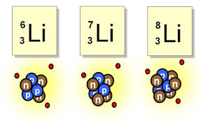
C1 Atomic Structure and the Periodic Table AQA Trilogy | In the periodic table, the elements are arranged in order of their ___________ number Elements in the same group, have the same number of ______________ Groups go ____________ Periods go ___________ | When developing the periodic table, Why did Medeleev leave gaps? Approximately how may elements are in the periodic table? | Properties of metals
Draw the electron structure for sodium | What is group 1 also known as? As you go down group 1, what happens to the reactivity? How many electrons are in the outer shell of a group 1 metal? | Delete as appropriate: If you remove electrons from an atom is becomes positive/ negative If you add electrons to an atom it becomes positive/negative | Properties of non-metals
Draw the electron structure for chlorine | What is group 7 also known as? As you go down group 7, what happens to the reactivity? What happens to melting point and boiling point as you go down the group? How many electrons are in the outer shell of a group 7 element? | What is an isotope? | To work out the relative atomic mass using the abundance of isotopes we can use the following calculation: (% of isotope 1 × mass of isotope 1) + (% of isotope 2 × mass of isotope 2) ÷ 100
Draw the electron structure for chlorine | What is group 0 also know as? In group 0, how many electrons are in the outer shell? How is boiling point affected as you go down the group? | Copper has two stable isotopes Cu-63 which has an abundance of 69.2% and Cu-65 which has an abundance of 30.8% Calculate relative atomic mass to 1dp. | In any sample of Chlorine 25% will be ₃₇Cl and 75% ₃₅Cl. Calculate the relative atomic mass to 1dp.

Slide 4
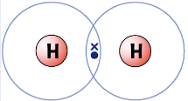
C2 Bonding, structure and the properties of matter AQA Trilogy | Ionic bonding Describe ionic bonding What bonds together? | Covalent bonding Describe covalent bonding What bonds together? | Draw the dot and cross diagram to show the covalent bonding in Nl₂
Define the following terms: Ion Electrostatic force Polymer Allotrope | Ionic bonding is represented with dot and cross diagrams Sodium chloride is shown below: | Covalent bonding is represented with dot and cross diagrams. The covalent bond between two hydrogen atoms is shown below: | Draw the dot and cross diagram to show the covalent bonding in H₂O
Write the charge of the following atoms when they form ions: Na Mg Cl K O Br S Ca | Draw the dot and cross diagram for magnesium oxide (MgO) | Draw the dot and cross diagram to show the covalent bonding in Cl₂ | Draw the dot and cross diagram to show the covalent bonding in CH₄
Give properties of ionic compounds | Draw the dot and cross diagram for magnesium chloride (MgCl₂) | Draw the dot and cross diagram to show the covalent bonding in O₂ | Draw the dot and cross diagram to show the covalent bonding in HCl

Slide 5
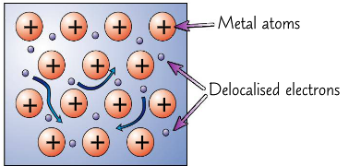
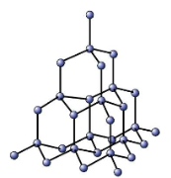
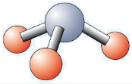
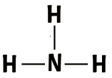
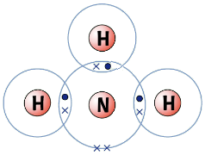
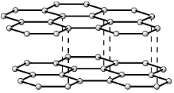
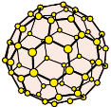
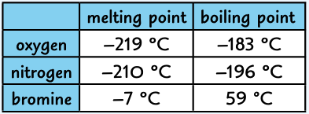
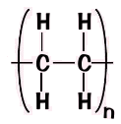
C2 Bonding, structure and the properties of matter AQA Trilogy | Diamond Number of covalent bonds from each carbon Melting point is low / high / very high Why doesn’t it conduct electricity? | Metallic bonding Describe metallic bonding What bonds together? | Metallic bonding
There are several ways to represent covalent bonds: | Graphite Number of covalent bonds from each carbon Melting point is low / high / very high Why does it conduct electricity? | Why are most metals: solid at room temperature? Good conductors of electricity and heat | Draw a diagram to show why alloys are harder than pure metals
The repeating unit of poly(ethene) is shown below. What is the molecular formula of poly(ethene) | Write about the uses of Fullerenes like Bucky balls and nanotubes | Draw a diagram to show why most metals are malleable | Predict the state of: Bromine at room temperature (25ºC) Nitrogen at room temperature (25ºC) Oxygen at – 220ºC
The reason that most polymers are solid at room temperature is: | Name the process: Solid → liquid Liquid → gas Gas → liquid Liquid → solid | Draw particle diagrams to show a solid, liquid and a gas solid liquid gas | Ethanol melts at -114ºC and boils at 78ºC. Predict the state at: -150ºC 0ºC 25ºC 100ºC

Slide 6
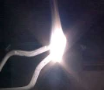
C3 Quantitative Chemistry AQA Trilogy | When magnesium burns, the mass increases. Explain why and write an equation | Write the equation for calculating the number of moles in a given mass (You need to be able to rearrange this) | What is meant by the term limiting reactant?
State what is meant by the law of conservation of mass | When calcium carbonate thermally decomposes, the mass decreases. Explain why and write an equation | Calculate the number of moles in: 66g of carbon 28g of N₂ gas 88g of CO₂ | Calculate the mass of aluminium oxide formed when 135g of aluminium is burned in air 4Al + 3O₂ → 2Al₂O₃
Relative formula mass (M_{r}) is calculated by adding the relative atomic masses of the atoms in the compound. Calculate the M_{r} of the following compounds: CO₂ H₂O NaCl CuSO₄ | Using M_{r} show that mass is conserved in the following reaction: 2Li + F₂ → 2LiF | Calculate the mass of carbon in 4 moles of CO₂ | Write the equation used to calculate concentration (You need to be able to rearrange this)
Find the percentage of sodium in sodium carbonate (Na₂CO₃) | What is the symbol for moles? What is the value of Avagadro’s constant? The mass of 1 mole is = to the ________ | 8.1g of zinc oxide reacts completely with 0.6g of carbon to form 2.2g of carbon dioxide and 6.5g of zinc. Write a balanced symbol equation (A_{r} C=12, O = 16 Zn = 65) | Calculate the concentration in g/dm³ of a solution of sodium chloride where 30g of sodium chloride is dissolved in 0.2dm³ of water

Slide 7
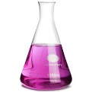
C4 Chemical changes AQA Trilogy | Delete as appropriate: When metals react they form positive / negative ions The more reactive a metal the more / less likely it is to form an ion Aqueous solutions of alkalis contain hydrogen / hydroxide ions | Define the following key terms: Oxidation Reduction Redox reaction Alkali Neutralisation | Define the following key terms: Ore Displacement Electrolysis
Metal + oxygen → Metal oxide Magnesium + oxygen → Zinc + oxygen → The above are oxidation reactions. Explain why | Reactive metal + water → metal hydroxide + hydrogen Lithium + water → Potassium + water → Calcium + water → Less reactive metals won’t react with water | Metal + acid → salt + hydrogen Magnesium + hydrochloric acid → Zinc + sulfuric acid → Iron + hydrochloric acid → | Metal oxide + acid → salt + water Copper oxide + hydrochloric acid → Zinc oxide + sulfuric acid → Magnesium oxide + nitric acid →
Acid + base → salt + water Hydrochloric acid + sodium hydroxide → H⁺ _{(aq)} + OH⁻ _{(aq)}→ | Metal carbonate + acid → salt + water + carbon dioxide Calcium carbonate + hydrochloric acid → Copper carbonate + sulfuric acid → | Metal hydroxide + acid → salt + water Lithium hydroxide + hydrochloric acid → Sodium hydroxide + sulfuric acid → Potassium hydroxide + nitric acid → | RPA 8: Describe how to prepare a pure, dry sample of a soluble salt
Name the salt produced when you use: Hydrochloric acid Sulfuric acid Nitric acid | The pH scale goes from ___ to ___ Numbers of pH less than 7 are __________ pH 7 is _________ Numbers of pH above 7 are ___________ | In relation to acids define the following terms: Dilute Concentrated Weak Strong | Write the symbols for: Hydrochloric acid Sulfuric acid Nitric acid

Slide 8
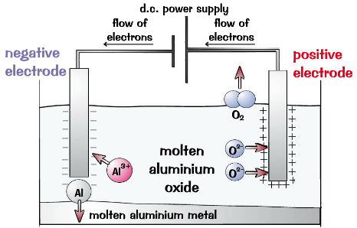
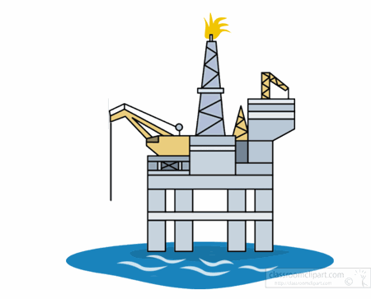
C4 Chemical changes AQA Trilogy | Write the reactivity series below and add on the symbols for each element | Electrolysis key terms: Electrolyte Cathode Anode Inert | In the electrolysis of lead bromide: What forms at the cathode? What forms at the anode? For electrolysis to occur the lead bromide must be solid/ molten
Unreactive metals such as _______ are found in the Earth as the metal itself. More reactive metals such as ________ are found in __________. Metals less reactive than carbon can be extracted using _________ with carbon. | Where does carbon fit into the reactivity series? Which metals can be extracted using carbon? | Using electrolysis to extract aluminium Why is aluminium oxide (bauxite) mixed with cryolite? Why must the positive electrode (anode) be continually replaced? What forms at the anode? What forms at the cathode? | RPA 9: Electrolysis – investigate what happens when aqueous solutions are Electrolysed. In solutions that do not contain a halide ion (Cl⁻,Br⁻,I⁻) Which gas is produced at the: Anode Cathode In solutions that contain a halide ion (Cl⁻,Br⁻,I⁻) Which gas is produced at the: Anode Cathode
Oxidation and reduction O I L R I G | Redox reactions The ionic equation for iron reacting with dilute hydrochloric acid is shown below Fe + 2H⁺ → 2Fe²⁺ + H₂ Iron is oxidised / reduced Fe-2e⁻ → Fe²⁺ Hydrogen is oxidised / reduced 2H⁺ + 2e⁻ → H₂ | Using electrolysis to extract aluminium | An aqueous solution of CuCl₂ is electrolysed using inert electrodes. Write the half equations for the anode cathode
Oxidation or reduction Mg + O₂ → 2MgO The magnesium is oxidised / reduced 2CuO + C → 2Cu + CO₂ The copper is oxidised / reduced | Displacement reactions More reactive metal will displace a less reactive metal Iron + copper sulfate → Magnesium + zinc chloride → Iron + zinc sulfate → | Write the words for the compounds below: NaOH CuCl₂ KSO₄ CaCO₃ MgO | Write the words for the compounds below: HCl H₂SO₄ HNO₃ Fe₂O₃ Ca(OH)₂

Slide 9
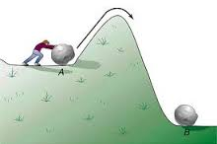
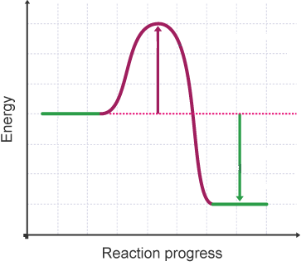
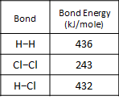
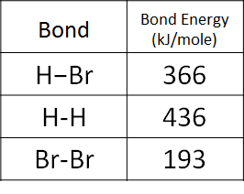
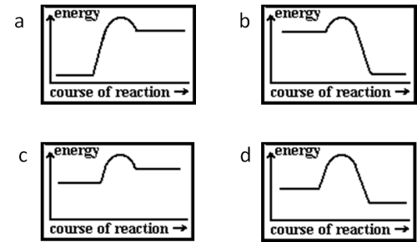
C5 Energy changes AQA Trilogy | Chemical reactions only occur if… | Activation energy is | The overall energy change of a reaction = The sum of the energy needed to break the bonds in the reactants - The sum of the energy needed to make the bonds in the products
Exothermic reactions What is an exothermic reaction Give examples of exothermic reactions Give useful applications of exothermic reactions | Delete as appropriate: Energy is released when bonds are made / broken. This is exothermic / endothermic Energy needs to be supplied when bonds are made / broken This is exothermic / endothermic | Energy level diagram label on: reactants, products, activation energy & energy change | Hydrogen and chlorine react to form hydrogen chloride gas: H₂ + Cl₂ → 2HCl Calculate energy change.
Endothermic reactions What is an endothermic reaction Give examples of endothermic reactions Give useful applications of endothermic reactions | In an exothermic reaction, the energy ________ from forming new bonds is greater than the energy needed to break existing bonds In an endothermic reaction, the energy needed to ________ existing bonds is greater than the energy released from forming new bonds | Sketch an energy level diagram to show an exothermic reaction with labels | Hydrogen bromide decomposes to form hydrogen and bromine: 2HBr → H₂ + Br₂ Calculate energy change
RPA 10: Temperature changes Describe how to tell is a reaction is exothermic or endothermic What measurements need to be taken? Why might the reaction mixture be placed in a polystyrene cup rather than a glass beaker? | Claire puts 25cm³ of ethanoic acid into a polystyrene cup with 25cm³ of potassium hydroxide. Both liquids started at 21ºC. After 2 minutes the temperature of the reaction mixture is 28.5ºC. Is the reaction endothermic or exothermic? | Sketch an energy level diagram to show an endothermic reaction with labels | State is the diagrams show endo or exothermic reactions

Slide 10
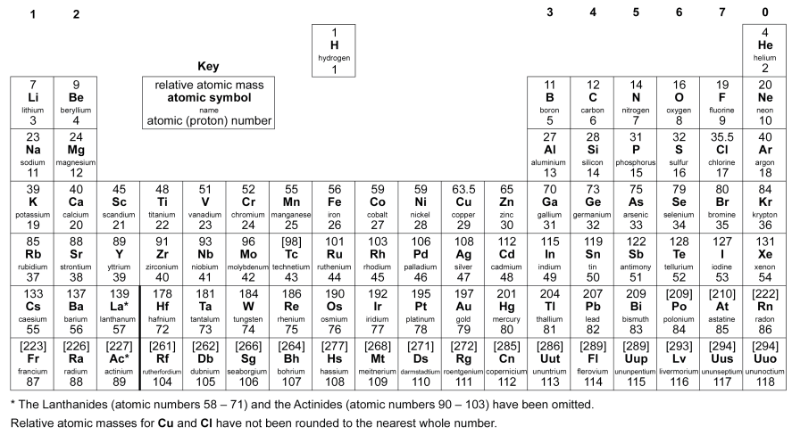
The Periodic Table

