Slide 1
AQA Trilogy - Physics

Slide 2
P1 Energy AQA Trilogy | An object with a mass of 5kg is dropped from a height of 10m, work out the speed with which it hits the ground (GPE = KE) | Calculate the kinetic energy of an object with mass of 50kg and is moving at a speed of 10m/s | Write the equation for calculating kinetic energy What does each letter stand for?
 | Describe the energy transfers: Bringing water to a boil in an electric kettle An object being propelled upwards A car braking | Work out the GPE of an object that has a mass of 2kg lifted though a height of 1.5m with a gravitational field strength of 9.8N/kg | Write the equation used to working out GPE (gravitational potential energy) What does each letter stand for?
Write the equation for calculating work done What does each letter stand for? | Calculate the work done when a force of 10N moves an object 2m | Calculate the energy stored in a spring when it is extended by 6cm. The spring has a constant of 150N/m Check your units! | Write the equation for working out elastic potential What does each letter stand for?
Write the two equations for working out power What does each letter stand for? | Machine A lifts a load of 100N through a height of 4m in 10s Machine B lifts a load of 150N through a height of 3m in 15s Which has more power? Show your workings | RPA 14: Determining SHC Calculate the energy change when a hot water bottle containing 1kg of water cools from 80°C to 30°C ( the SHC of water is 4200J/kg°C) | Write the equation for calculating the change in thermal energy What does each letter stand for?
The 8 energy stores

Slide 3
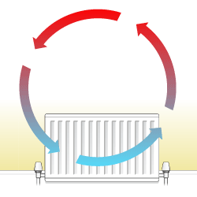
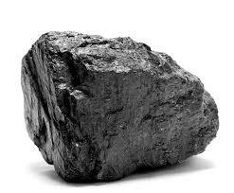
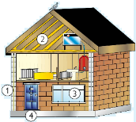
P1 Energy AQA Trilogy | Describe conduction What is meant by thermal conductivity? | Describe convection | List how energy resources can be used
Define the term Watt Calculate the energy transfer if a 60W lightbulb is on for 100s | Write the 2 equations for calculating energy efficiency | What is a renewable energy resource? Can you name 7? | What is a non-renewable energy resource? Name 3:
Describe the law of conservation in a closed system | A motor in a remote controlled car transfers 300J of energy to the cars energy stores. 225J are transferred to the cars kinetic energy stores. Calculate the efficiency of the motor | Describe how global warming occurs Describe how acid rain forms | Give examples of other environmental problems associated with using non- renewable fuels
Describe ways of reducing unwanted energy transfers | A blender is 70% efficient. If has a total input power of 600W. Calculate the useful power output | Describe ways to increase the efficiency of an energy transfer | Give examples of ways you can insulate your house

Slide 4
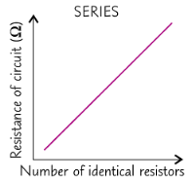
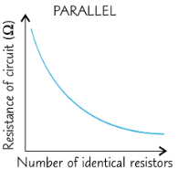
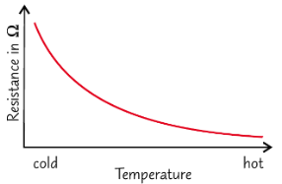
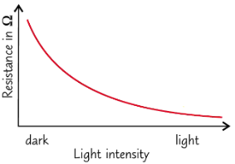
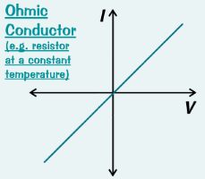
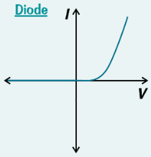
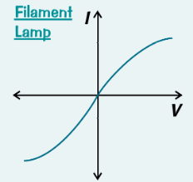
P2 Electricity AQA Trilogy | Write the equation for calculating charge flow What do the letters stand for? | A battery charger passes a current of 2.0 A through a cell over a period of 2.5 hours. How much charge is transferred to the cell? | RPA 15: Resistance How does increasing a length of wire affect the resistance in a circuit?
Draw the symbols for the following: Lamp Voltmeter Ammeter Fuse Diode LED | Write the equation for calculating potential difference What do the letters stand for? | A 4 Ω resistor in a circuit has a potential difference of 6.0V across it. What is the current through the resistor? You’ll need to rearrange the equation | RPA 15: Resistance Describe the difference between resistance in a series and parallel circuit.
Draw the symbols for the following: Resistor Variable resistor Thermistor LDR | How does the resistance of a thermistor change as temperature increases? Give a use of a thermistor | How does the resistance of an LDR change as light intensity increases? Give a use of an LDR | RPA 16: I-V characteristics Describe the resistance through an ohmic conductor
Define the term electric current | Draw a series circuit diagram that consists of 2 cells and a lamp and show the set up to measure current going through the circuit and voltage across the lamp | RPA 16: I-V characteristics Describe the resistance through a diode | RPA 16: I-V characteristics Describe the resistance through a filament lamp

Slide 5
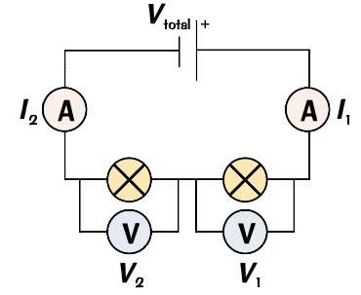
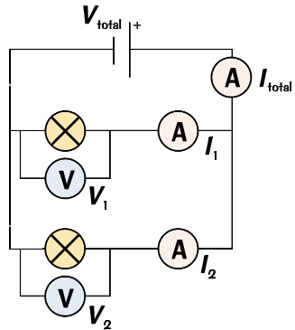
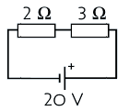
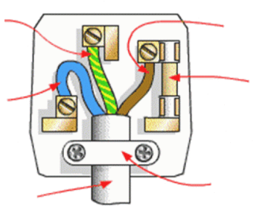
P2 Electricity AQA Trilogy | For components connected in series: The current through each component is the _________ The total potential difference of the power supply is ___________ between the components The total resistance of two components is the _______ of each component R_{total}= R₁ ₊ R₂ | For components connected in parallel: The total current through the whole circuit is the _______ of the currents through the separate components The potential difference across each component is the ________ The total resistance of two components is _______ than the resistance of the smallest individual resistor | A 600W microwave I used for minutes. How long would a 750W microwave take to do the same amount of work? Energy transfer (J) = Power (W) x time (s)
Draw a parallel circuit with 2 cells and 3 lamps that can be switched on and off independently | Series circuit | Parallel circuit | The motor in an electric toothbrush is attached to a 3 V battery. 140 C of charge passes through the circuit as it is used. Calculate the energy transferred. Energy transferred (J) = Charge flow (Q) x pd (V)
For the circuit diagram, calculate the current passing through the circuit. | Two 12V cells are connected in series with three resistors. 2Ω, 5Ω and 7Ω. Calculate the current through the circuit. | Write the two equations to work out power | Why is the national grid an efficient way to transfer energy?
Mains electricity Is it ac or dc? What is the frequency? What is the voltage? Describe the difference between ac and dc | Write the colour and function of the wires below: Live wire Neutral wire Earth wire | Label the diagram of a 3 pin plug | Describe the role of: Step up transformers Step down transformers

Slide 6
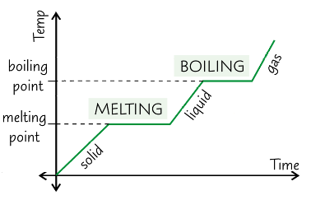
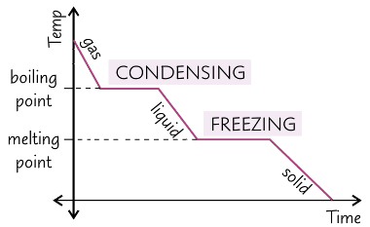
P3 Particle model AQA Trilogy | Write the equation used to calculate density | A cube has edges of length 1.5cm and an average density of 3500kg/m² What is its mass? Check your units! | RPA 17: Density Describe how to find the density of an irregularly shaped object
Draw particle diagrams for: solid liquid gas | Describe how mass is conserved as a substance changes state from solid→ liquid → gas | Write the equation for working out change in thermal energy | Calculate the change in thermal energy when 2kg of water is heated from 20ºC to 80ºC
Define the terms: internal energy Specific heat capacity Specific latent heat | Explain why changing the temperature of a fixed volume of gas, changes the pressure. | Write the equation for working out energy for a changing state | The specific latent heat of vaporisation for water (boiling) is 2260000 J/kg. How much energy is needed to completely boil 1.50kg of water at 100ºC
Describe the heating graph | Describe the cooling graph | Explain why there are flat parts on the heating and cooling graphs | Describe the movement of particles in a gas Pressure and volume are inversely proportional. That means that at volume goes up pressure goes ____________

Slide 7
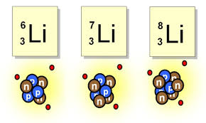
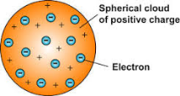
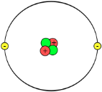
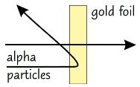
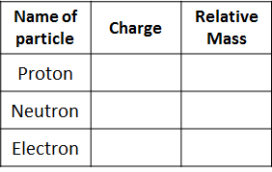
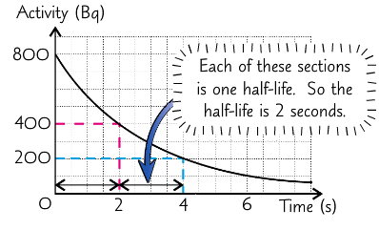
P4 Atomic structure AQA Trilogy | Describe the difference between the plum pudding and the nuclear model of an atom | What is an isotope? | Describe Alpha decay and complete the nuclear equation
What is the approximate radius of an atom? What is the approximate size of a nucleus? | Where in an atom are the neutrons and proton? The number of protons = the number of_________ Atomic number is the number of _________ Mass number is the number of ________ + the number of _________ Isotopes have a different number of ____________ | Describe the following (include: penetration, range and ionising power) Alpha particle (α) Beta particle (β) Gamma ray (Υ) | Describe Beta decay and complete the nuclear equation
Number of protons = Number of neutrons = Number of electrons = | Explain what was doing out from the alpha scattering experiment | Define the term half-life Give the unit for ‘activity’ What is the function of a Geiger-Muller tube? | Define the terms: Contamination Irradation Background radiation
 | How did Niels Bohr adapt the nuclear model of the atom? | Graph showing half life | The activity of a sample is 640 Bq. Calculate the final activity after two half-lives.

Slide 8
Physics equations to learn AQA Trilogy P1-4 | Weight = mass x gravitational field strength W= mg | Power = energy transferred ÷ time P = E t | Power = (current)² x resistance P = I² R
Charge flow = current x time Q = I t | Work done = force x distance W = Fs | Power = work done ÷ time P = W t | Energy transferred = power x time E = P t
Potential difference = current x resistance V = I R | Kinetic energy = 0.5 x mass x (speed)² E_{k} = ½ mv² | Efficiency = useful output energy transfer total input energy transfer | Energy transferred = charge flow x potential difference E = Q V
Power = potential difference x current P = VI | Gravitational potential energy = mass x gravitational field strength x height E_{p} = m g h | Efficiency = useful power output total power input | Density = mass ÷ volume P = m v

Slide 9
