Slide 1
MIND MAPS/SPIDER DIAGRAMS
PURPOSE AND CONTENT

Slide 2
STARTER ACTIVITY
You have been asked to design a TV advert for a new virtual reality games system called ‘Virtu-X’ which is to be aimed at teenagers and young adults
Create a mind map for the advert that covers the following:
Colours
Music/sound effects
Scenes
Text

Slide 3
STARTER ACTIVITY
Primary colours
Bright and bold
You have been asked to design a TV advert for a new virtual reality games system called ‘Virtu-X’ which is to be aimed at teenagers and young adults
Create a mind map for the advert that covers the following:
Colours
Music/sound effects
Scenes
Text
High contrast
Energetic
colours
Include logo
Large title
Energetic music
Virtu-X
text
music/sfx
Simple language
Modern font
Game SFX
Teen playing with headset
Teen excited to open box
scenes
Footage of some of the games
High energy games

Slide 4
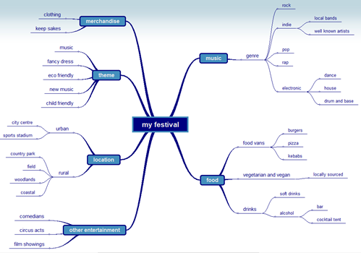
WHAT IS A MIND MAP/SPIDER DIAGRAM?
A mind map or spider diagram (they are the same thing) is a way of organising thoughts and ideas using a diagram
It is based around a central theme (node) and has branches off for the different aspects (sub nodes)
KEY WORDS
Node – the main point on the map that has information or ideas
Sub node – also has information but it relates to the node it is connected to
Branch – a line joining nodes and sub nodes
NODE
SUB-NODE
BRANCH

Slide 5
WHY DO WE USE MIND MAPS?
Think about why you might want to use a mind map/spider diagram. If possible, discuss the reasons with a parent/carer or sibling and share ideas
If it helps, try to think of an example situation or use the example of a festival from the last slide
ANSWERS ON THE NEXT FEW SLIDES

Slide 6
WHY DO WE USE MIND MAPS?
TO HELP GENERATE IDEAS AND SHOW OPTIONS FOR IDEAS

Slide 7
WHY DO WE USE MIND MAPS?
TO HELP GENERATE IDEAS AND SHOW OPTIONS FOR IDEAS
TO DEVELOP IDEAS AND SHOW LINKS BETWEEN THEM

Slide 8
WHY DO WE USE MIND MAPS?
TO HELP GENERATE IDEAS AND SHOW OPTIONS FOR IDEAS
TO DEVELOP IDEAS AND SHOW LINKS BETWEEN THEM
TO SHOW THE CONTENT OF THE PRODUCT

Slide 9
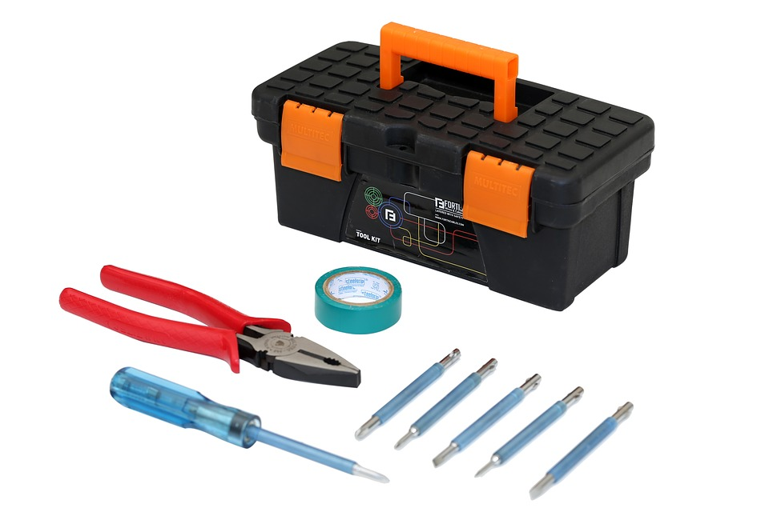
WHY DO WE USE MIND MAPS?
TO HELP GENERATE IDEAS AND SHOW OPTIONS FOR IDEAS
TO DEVELOP IDEAS AND SHOW LINKS BETWEEN THEM
TO SHOW THE CONTENT OF THE PRODUCT
TO SHOW RESOURCES, EQUIPMENT OR CONTENT IS NEEDED

Slide 10
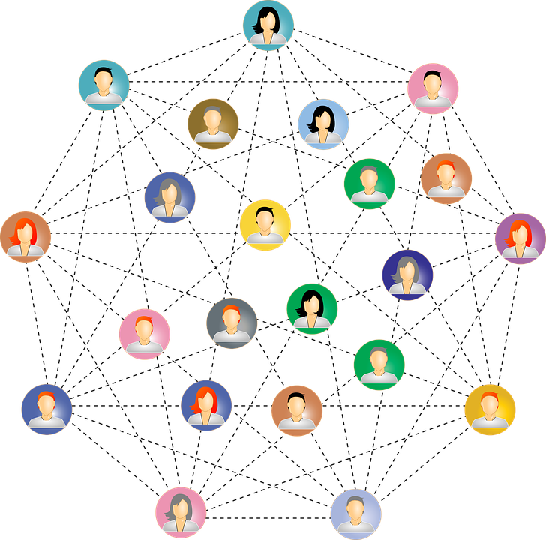
WHY DO WE USE MIND MAPS?
TO HELP GENERATE IDEAS AND SHOW OPTIONS FOR IDEAS
TO DEVELOP IDEAS AND SHOW LINKS BETWEEN THEM
TO SHOW THE CONTENT OF THE PRODUCT
TO SHOW RESOURCES, EQUIPMENT OR CONTENT IS NEEDED
TO SHOW HOW IDEAS ARE CONNECTED

Slide 11
WHAT CAN YOU REMEMBER?
Have a go at Activity 2.1 to see what you can remember
You have 5 minutes for this task

Slide 12
CREATE A MIND MAP
You’re now going to have a go at creating a mind map in the same way you could get asked to in the exam
Before you do this, we’re going to look at an example and mark the answer so that you can see how marks are awarded
The mark criteria on the next slide has been annotated to help you mark the example answer

Slide 13
WHAT IS SAYS | WHAT TOP MARK BAND LOOKS LIKE
Clear structure with logical connections Structure of diagram is clear but may not be totally logical Diagram has little structure and/or links may not be totally logical | There is an obvious central node with branches coming out to sub-nodes that are clearly labelled. There may be additional branches from these sub-nodes to more sub-nodes and these must make sense
Content is relevant to context and the development of a website for the ride Content not fully relevant to context and the development of a website for the ride Content may not be appropriate | The information is relevant to the scenario or the development of a website in general. Note: the scenario here is the development of the website for the ride, not the ride itself
Detail is clear and understandable Detail is mostly clear and understandable Detail is unclear and difficult to understand | It is easy to understand your thought process - the examiner will easily be able to see how all the content connects
Subject specific terminology will be used Subject specific terminology may be occasionally used Little or no subject specific terminology used | You have used technical language e.g. image rather than picture. Other technical language for a website can include navigation, rollover, hyperlink, named anchor

Slide 14
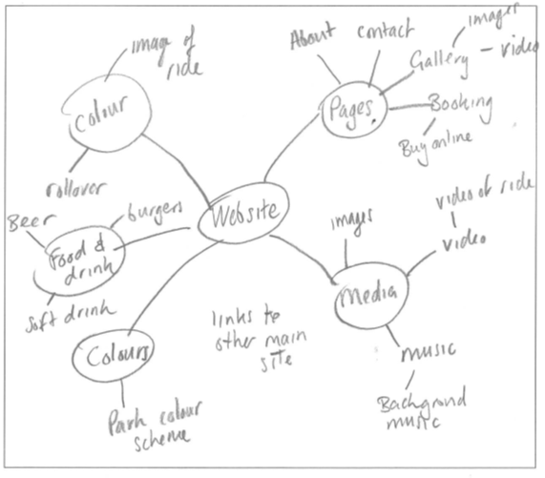
Level 3: 6–7 Marks Clear structure with logical connections. Content is relevant to context and the development of a website for the ride. Detail is clear and understandable. Subject specific terminology will be used.
Level 2: 4–5 Marks. Structure of diagram is clear but may not be totally logical. Content not fully relevant to context and the development of a website for the ride. Subject specific terminology may be occasionally used.
Level 1: 1–3 Marks Diagram has little structure. Content may not be appropriate Links may not be totally logical. Little subject specific terminology will be used
4 MARKS

Slide 15
HAVE A GO
Level 3: 6–7 Marks
Clear structure with logical connections.
Content is relevant to context and the development of a website for the ride.
Detail is clear and understandable.
Subject specific terminology will be used.
Level 2: 4–5 Marks.
Structure of diagram is clear but may not be totally logical.
Content not fully relevant to context and the development of a website for the ride.
Subject specific terminology may be occasionally used.
Level 1: 1–3 Marks
Diagram has little structure.
Content may not be appropriate
Links may not be totally logical.
Little subject specific terminology will be used
Now you know how marks are awarded, have a go at answering the same question in activity 2.3
To help, the mark scheme is on the right - this will not be given in the exam
Remember all diagrams must be drawn in pencil

