Slide 1
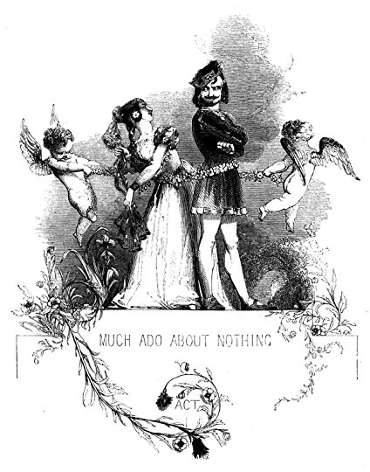
Much Ado About Nothing
Penitent
-feeling or showing sorrow and regret for having done wrong; repentant.
Humorous
-causing laughter and amusement; comic.
Scheming
-Obsesses over evil plans that cause harm to others.
Scheme
Manipulate
- control or influence (a person or situation) cleverly or unscrupulously..
Manipulative
Slander
- words falsely spoken that damage the reputation of another
Chastity
-the state or practice of refraining from extramarital, or especially from all, sexual intercourse.
Comedy
-A play with a happy ending
Vow
-a solemn promise.
Foil
In fiction, a foil is a character who contrasts with another character —usually the protagonist— in order to highlight particular qualities of the other character.
Allegiance
-loyalty or commitment to a superior or to a group or cause.
Cuckold
-the husband of an adulteress, often regarded as an object of derision.
Courtier
-a person who attends a royal court as a companion or adviser to the king or queen.
Dichotomy
-A division or contrast between two things that have polar or opposite qualities (e.g. good and bad, fair and foul).
Masquerade
- A masked ball

